Slide 1
AI STUDY BUDDY
Team Project - MSc Computer Science
Anika Siddiqui Mayesha – D24125187
Lorenzo Palleschi – D24126922(Team Lead)
Rumaysa Babulkhair – D24125711
Yurii Sykal – C23512523

Slide 2

BRIEF WEEKLY OVERVIEW
System Architecture Diagrams
Figma Design Overview
Figma Coded Versions
Logo Design
Retrospectives

Slide 3
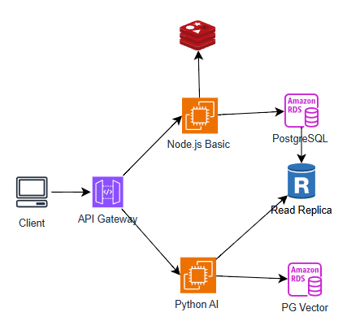
SYSTEM ARCHITECTURE DIAGRAM

Slide 4
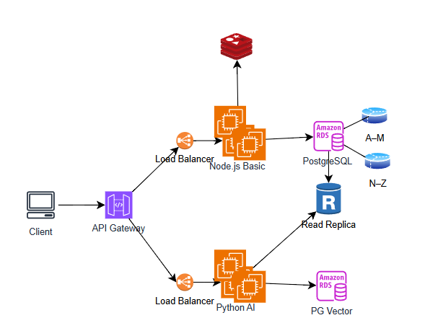
SYSTEM ARCHITECTURE DIAGRAM

Slide 5
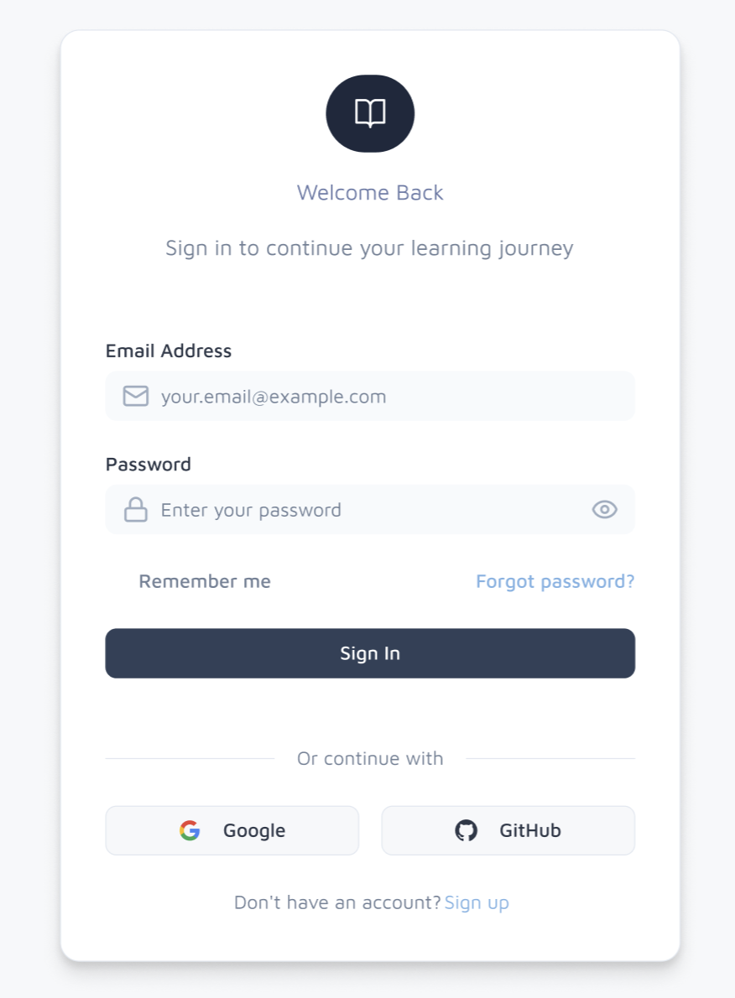
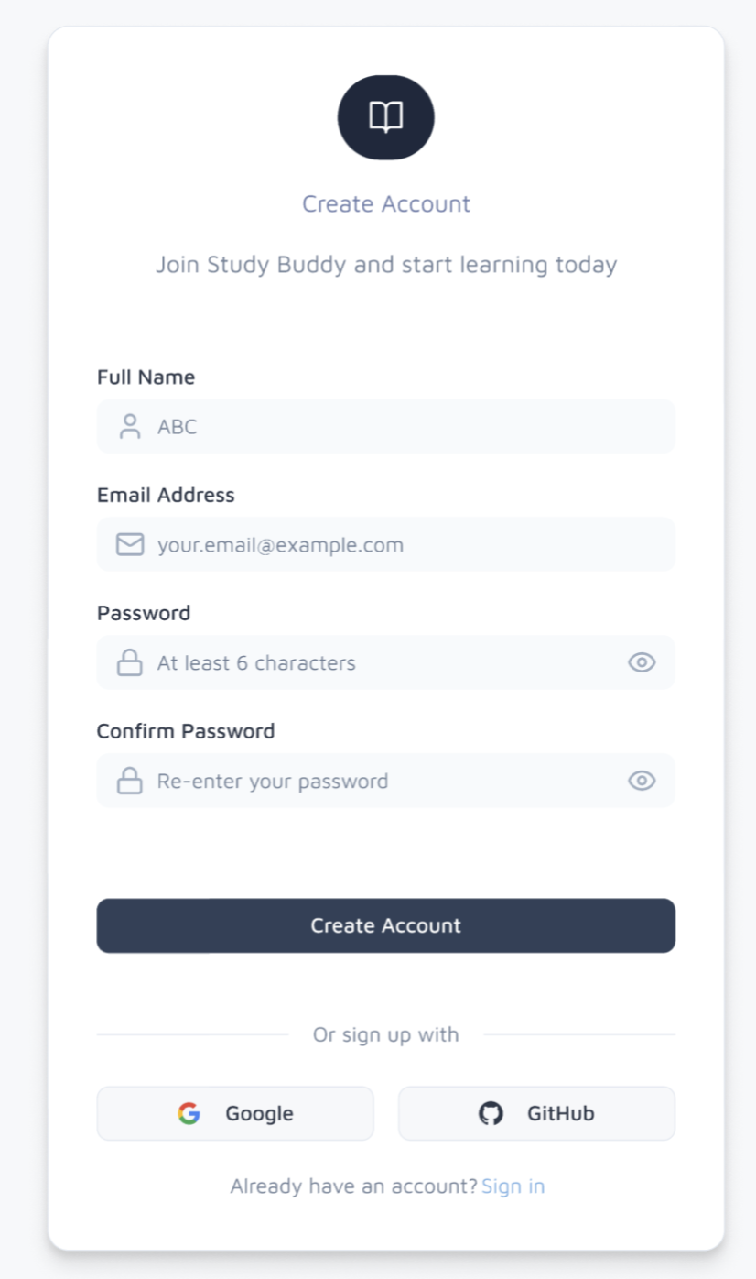
FIGMA DESIGN (Login/Register)

Slide 6
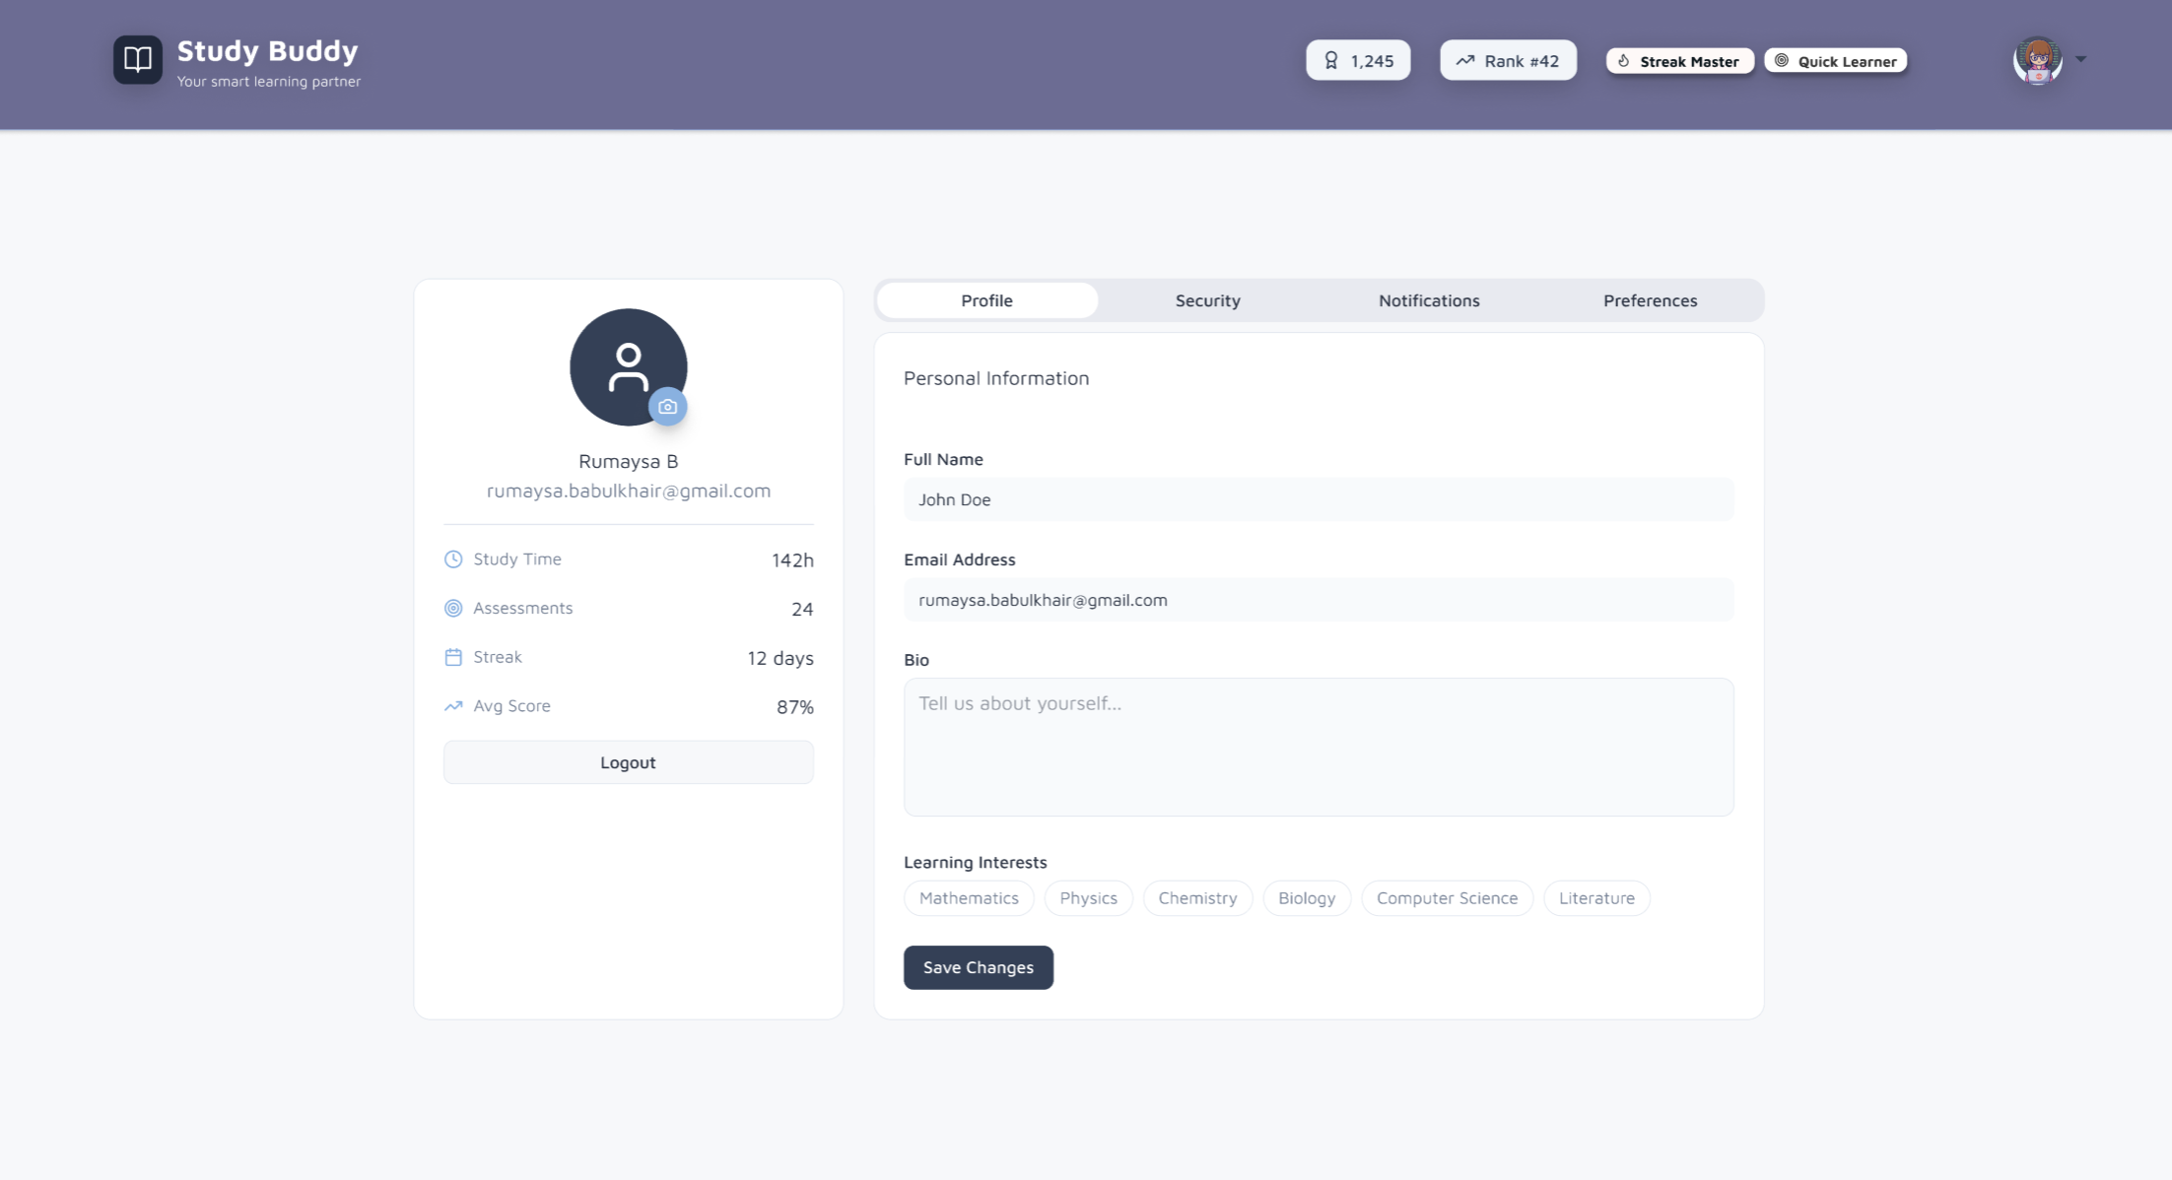
FIGMA DESIGN (Account)

Slide 7
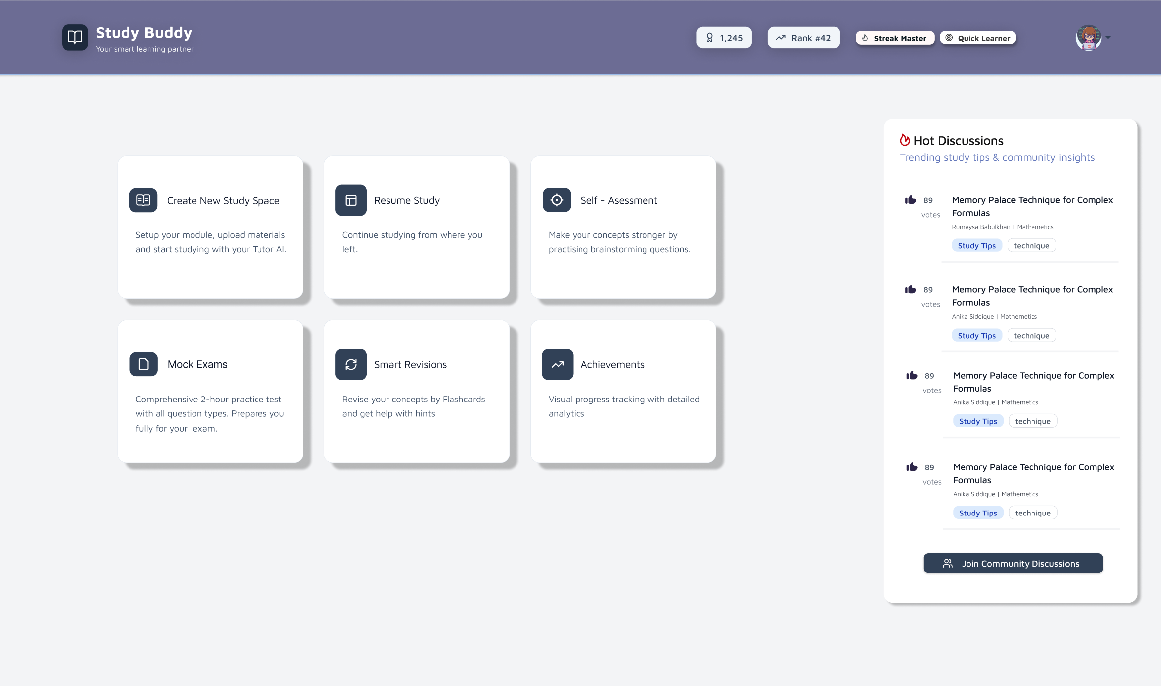
FIGMA DESIGN (DASHBOARD)
Figma design is now updated with a sleeker interface
More neutral colour scheme

Slide 8
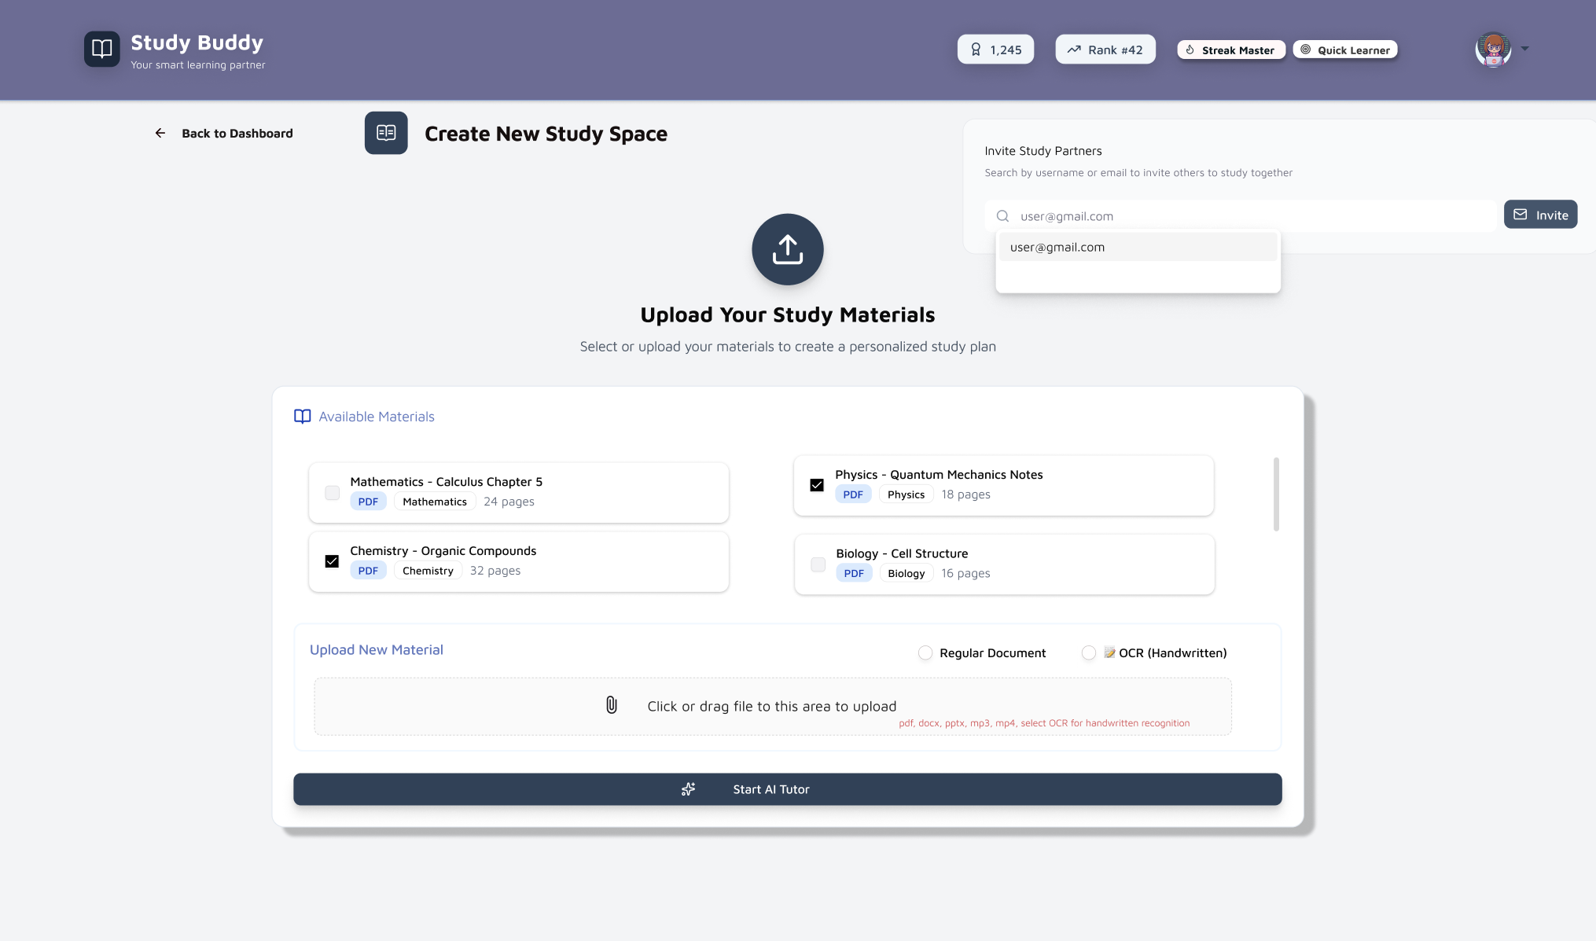
FIGMA DESIGN (STUDY SPACE)
Study materials can be uploaded (various types listed)
Available material can be selected
Study Partners may also be invited

Slide 9
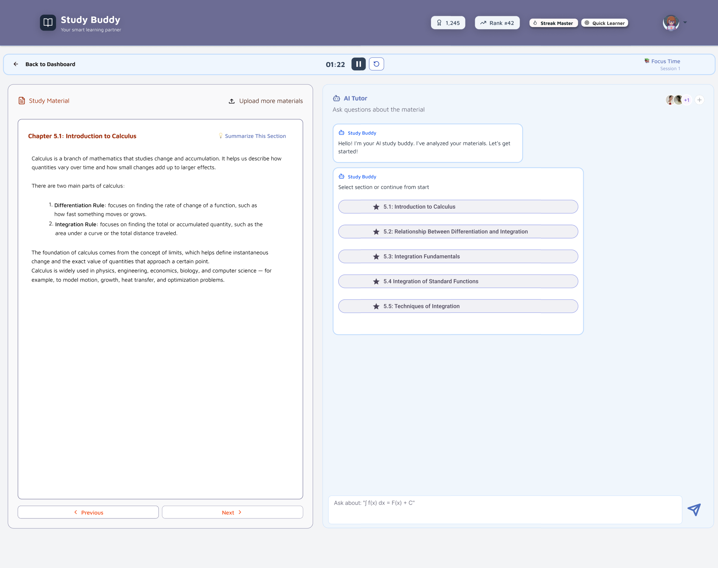
FIGMA DESIGN (AI TUTOR)

Slide 10
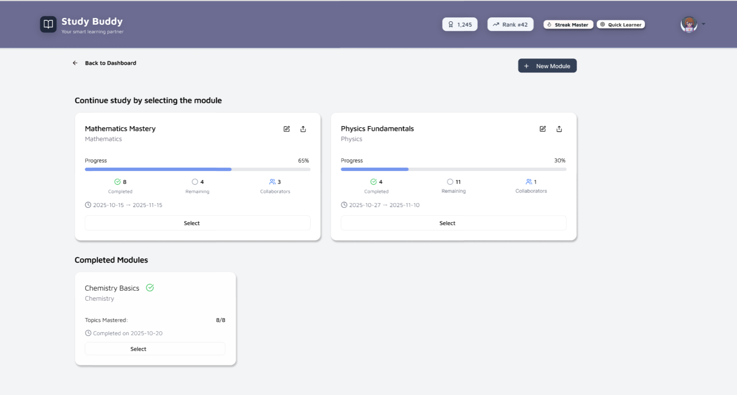
FIGMA DESIGN (Resume Study)

Slide 11
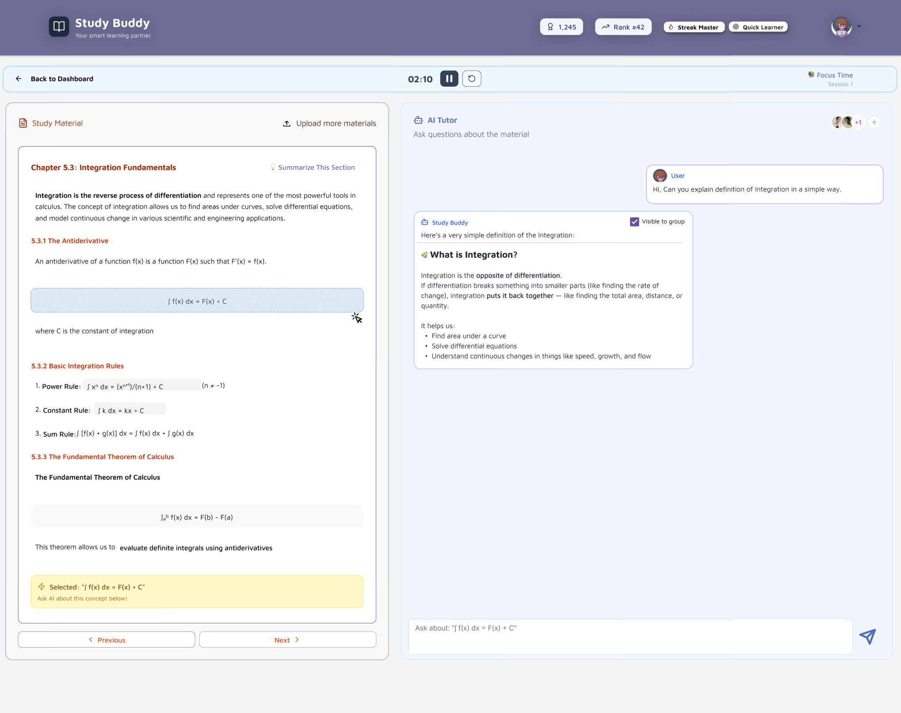
FIGMA DESIGN (AI TUTOR #2)

Slide 12
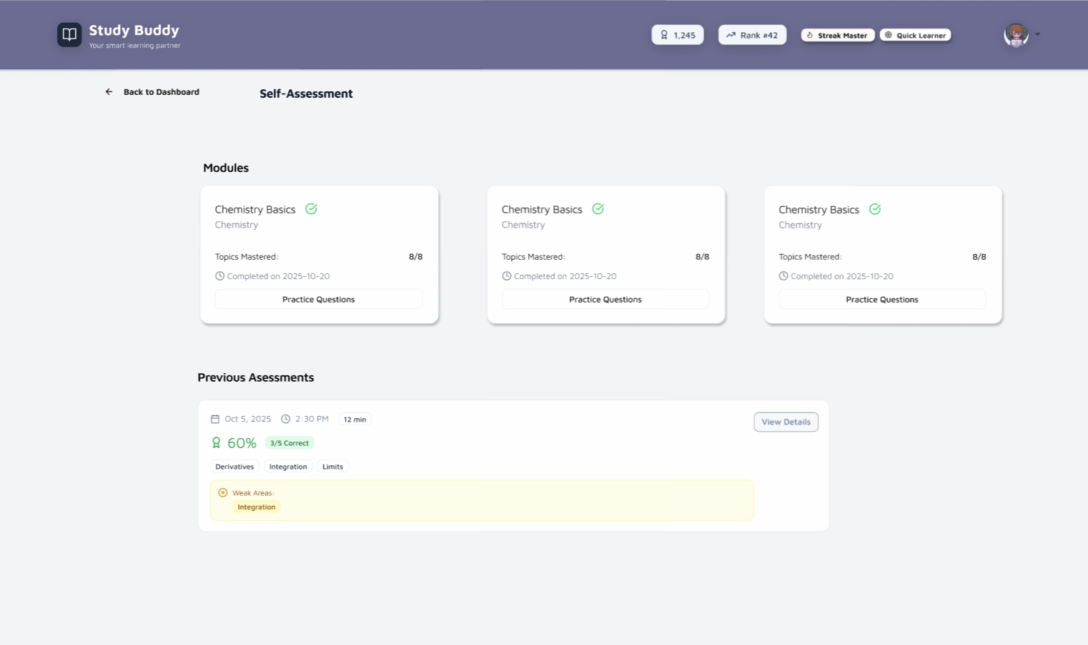
FIGMA DESIGN (Self-Assessment)

Slide 13
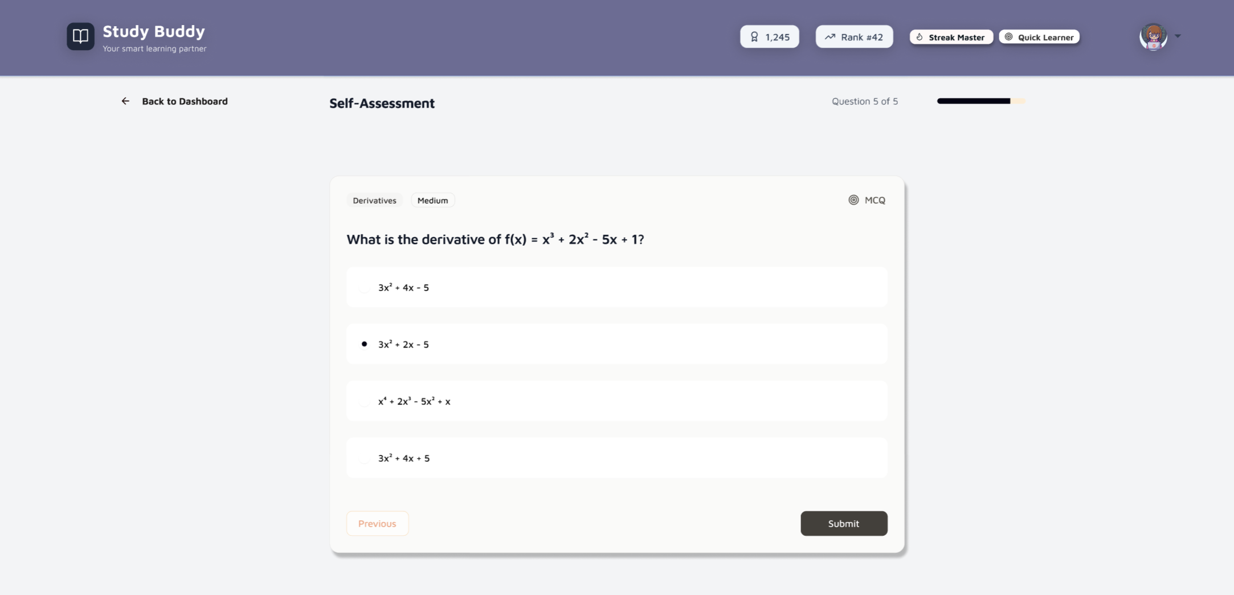
FIGMA DESIGN (Self-Assessment)

Slide 14
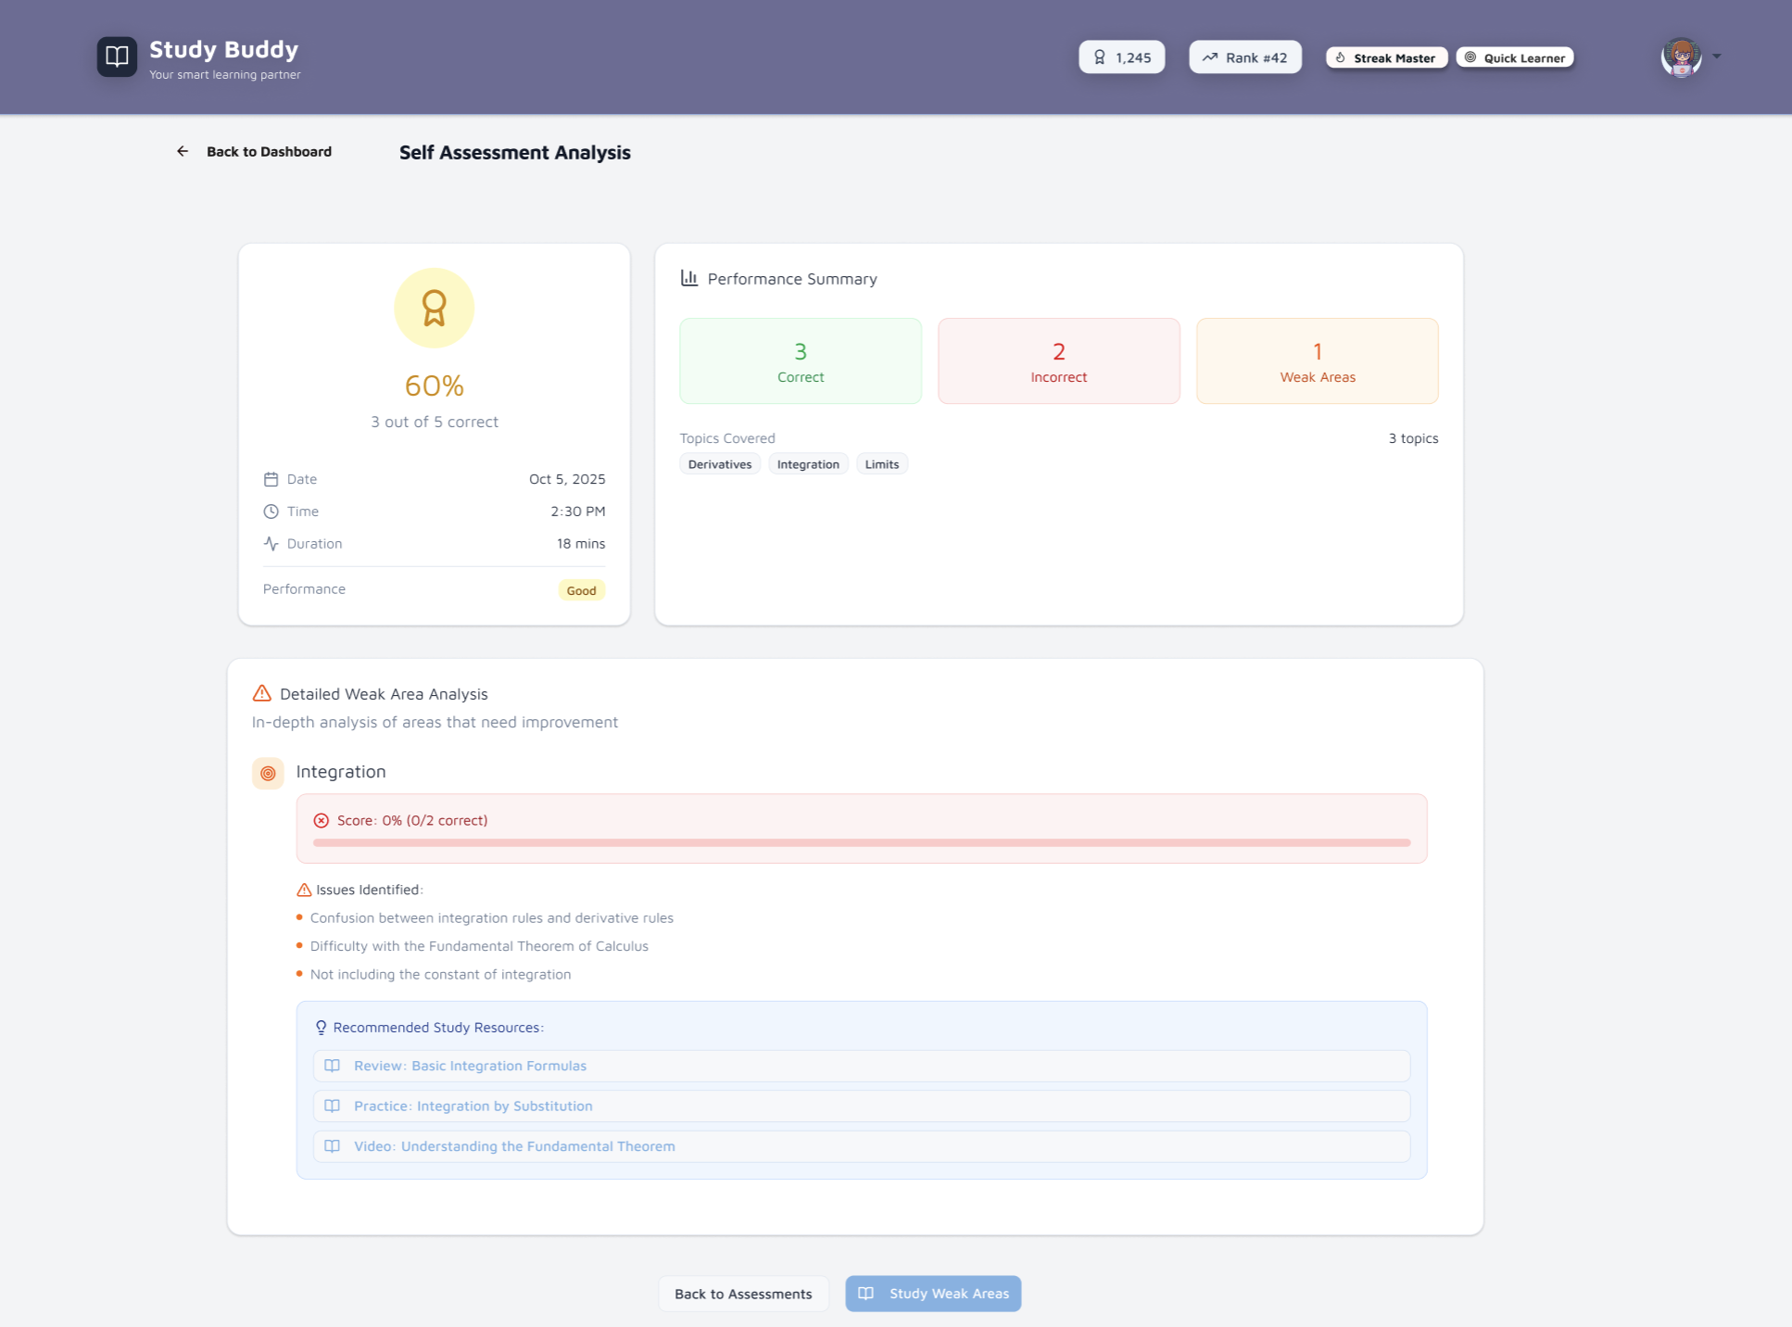
FIGMA DESIGN (Self-Assessment)

Slide 15
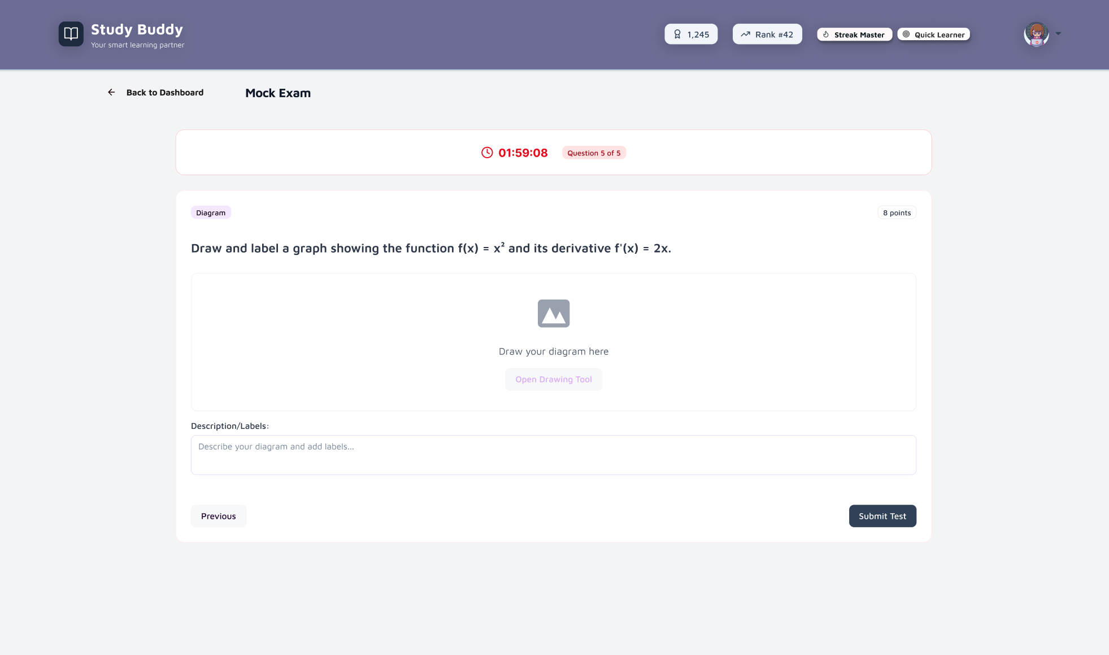
FIGMA DESIGN (MOCK EXAM)

Slide 16
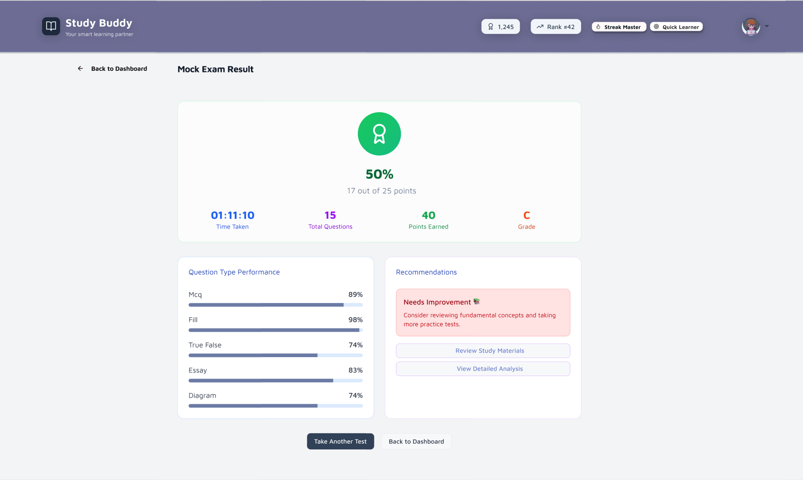
FIGMA DESIGN (MOCK RESULTS)

Slide 17
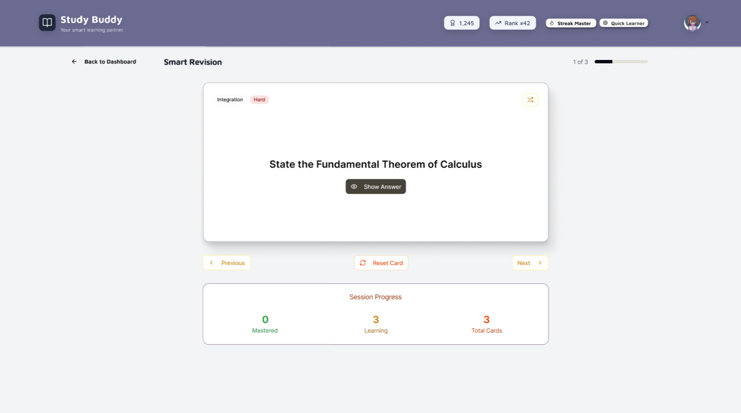
FIGMA DESIGN (Revision)

Slide 18
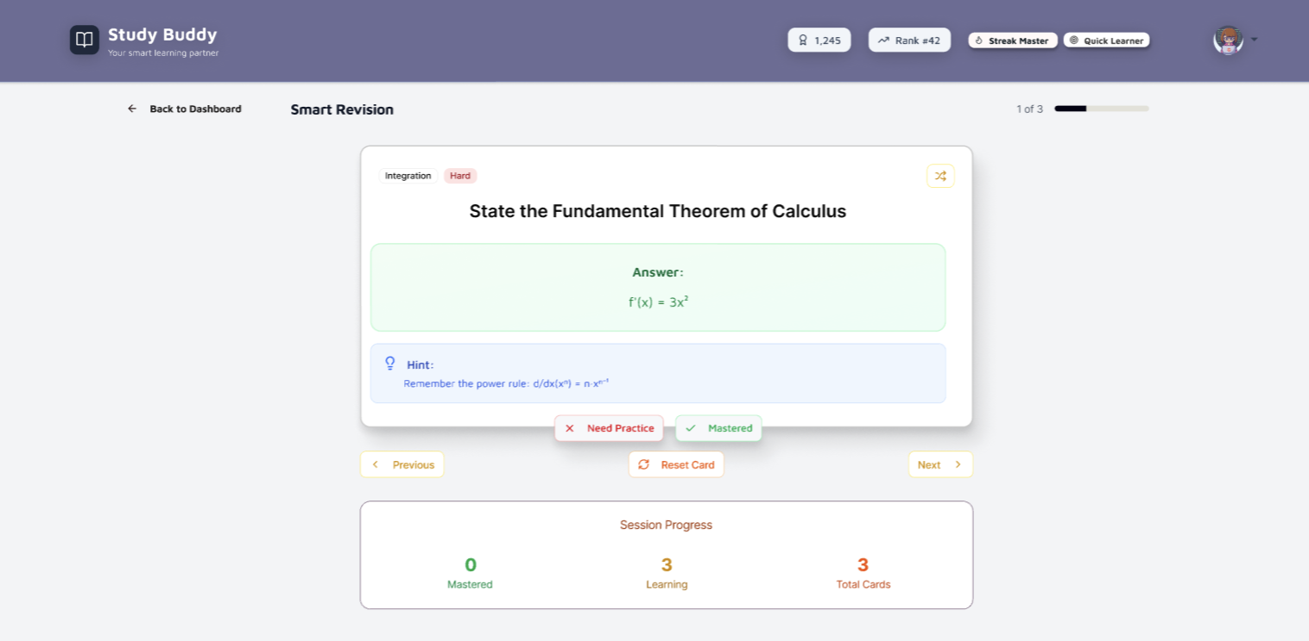
FIGMA DESIGN (Revision)

Slide 19
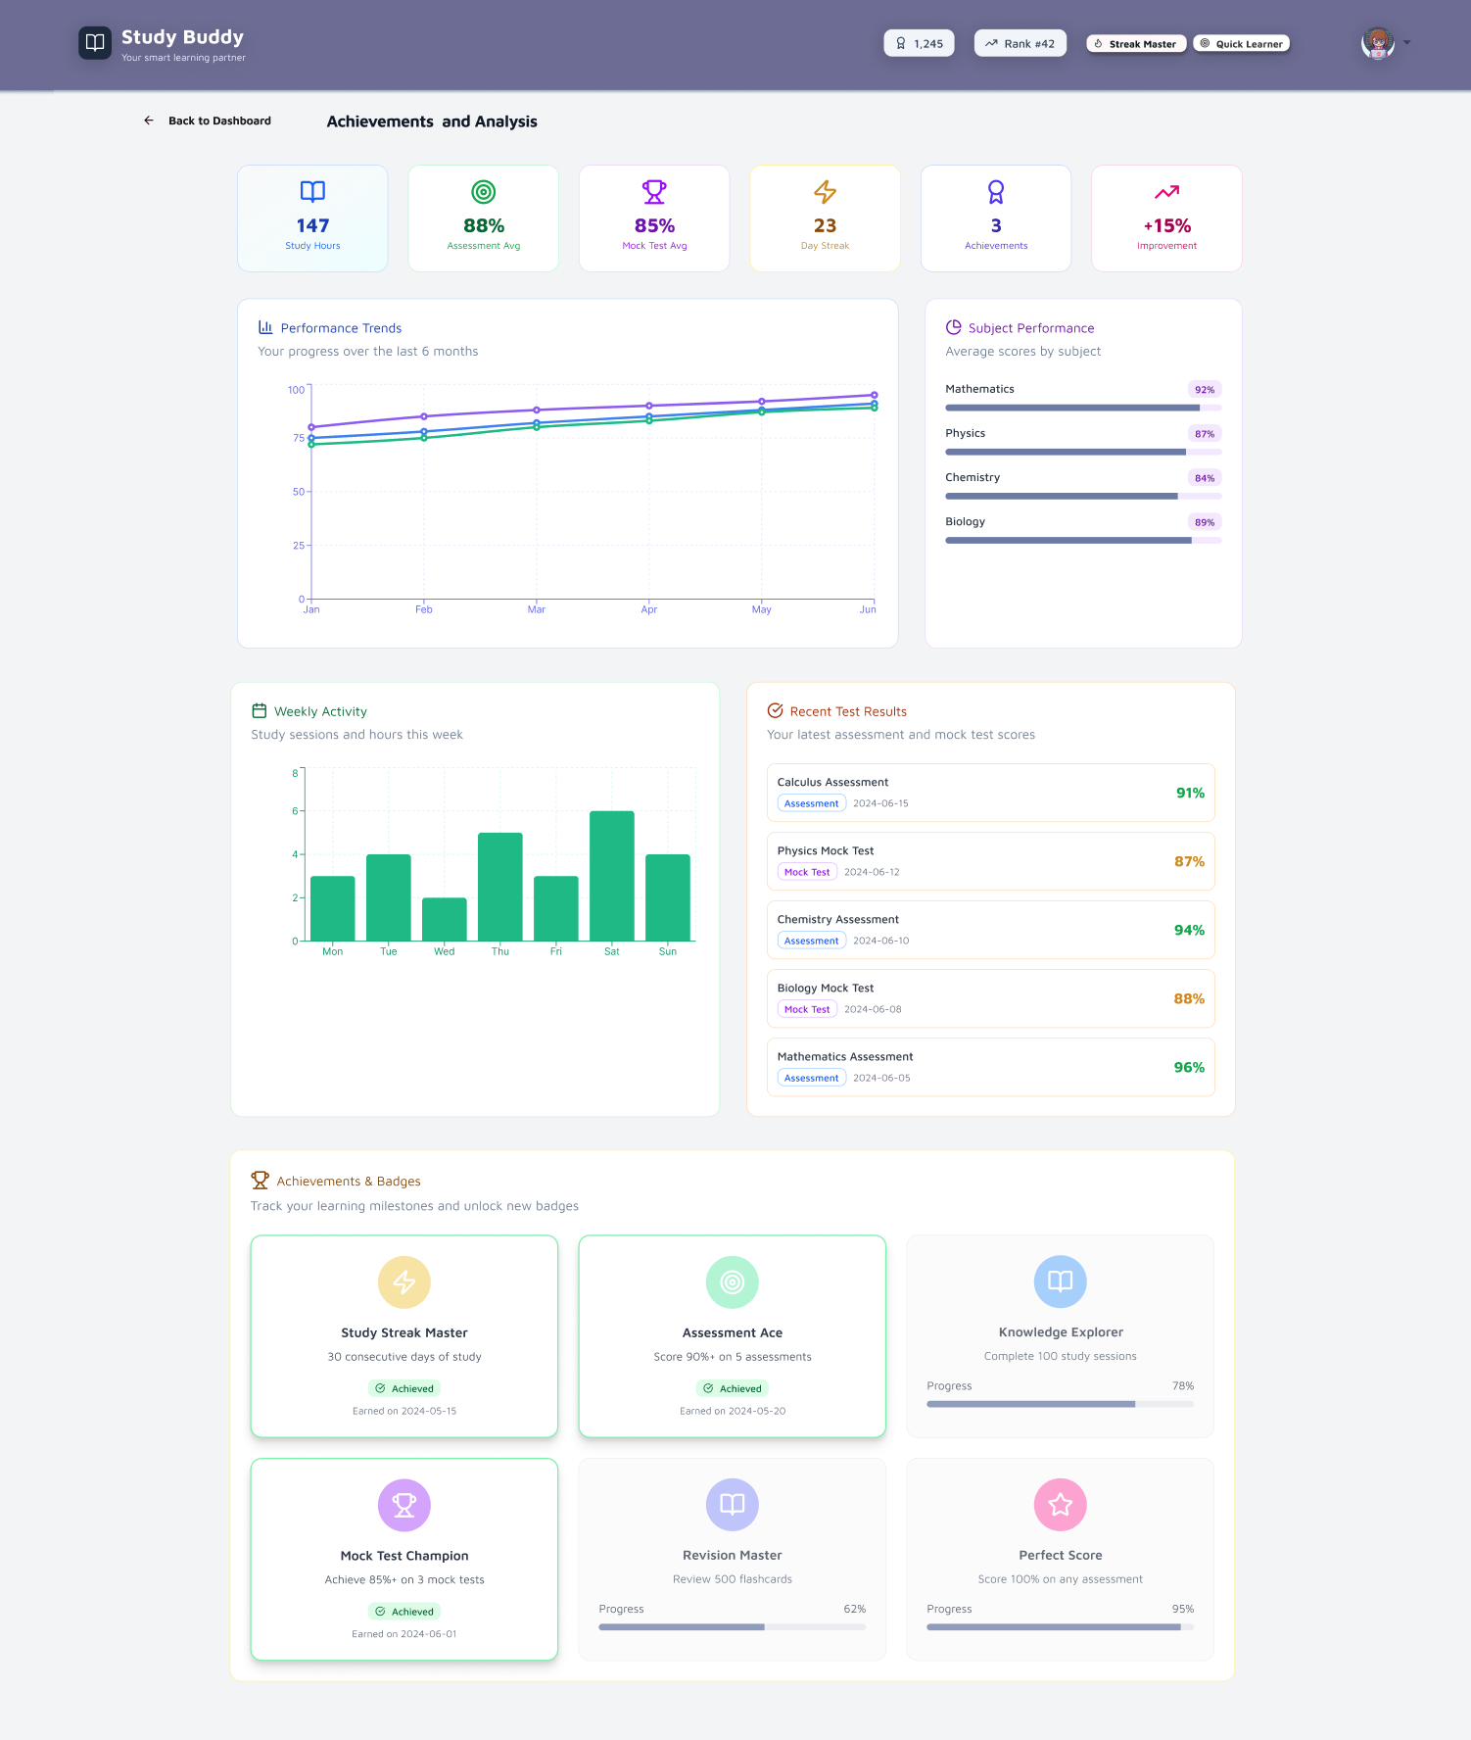
FIGMA DESIGN (ACHIEVEMENTS)

Slide 20

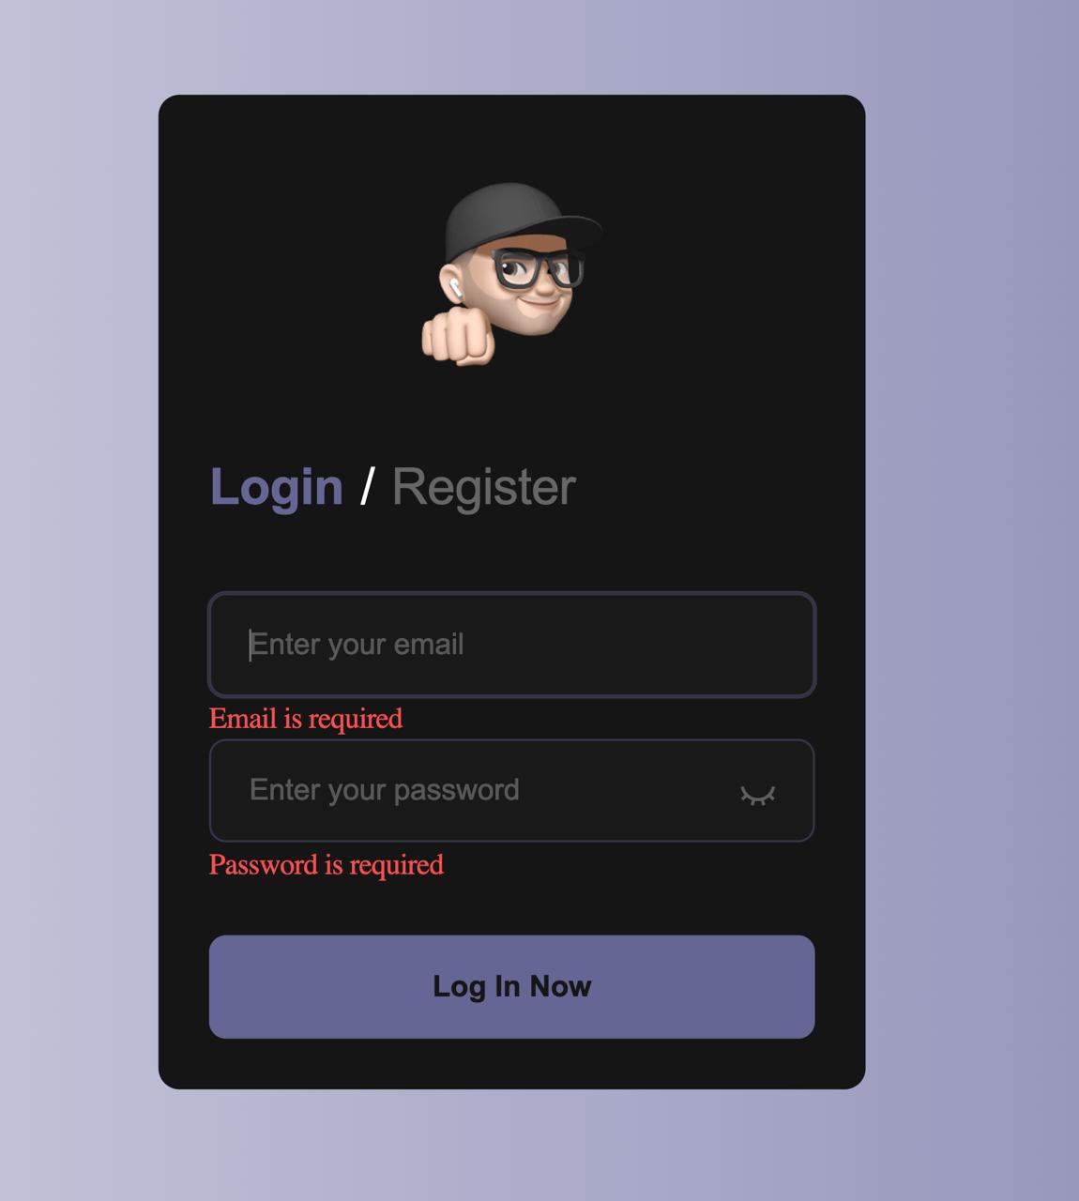
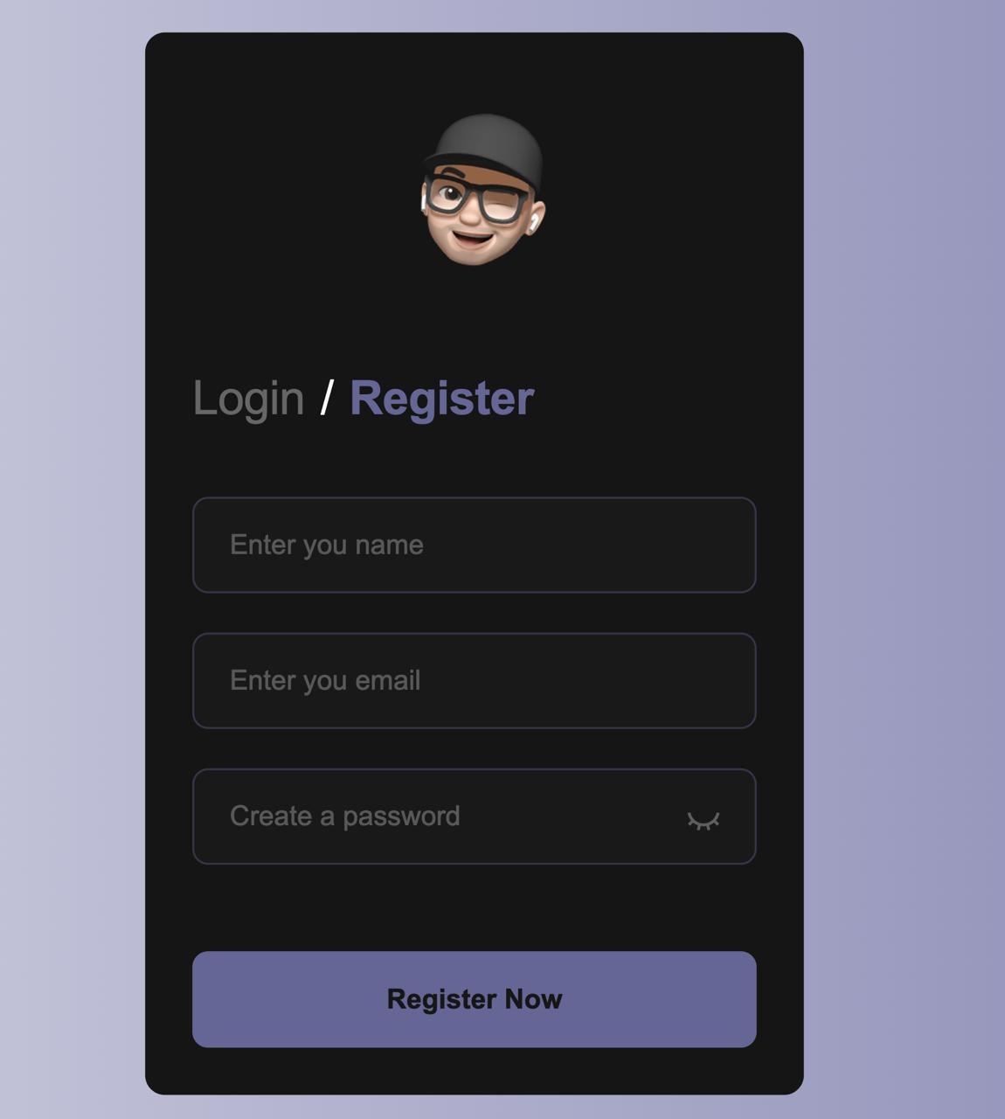
LOGIN/REGISTRATION PAGE
• Initial version (1.0)

Slide 21
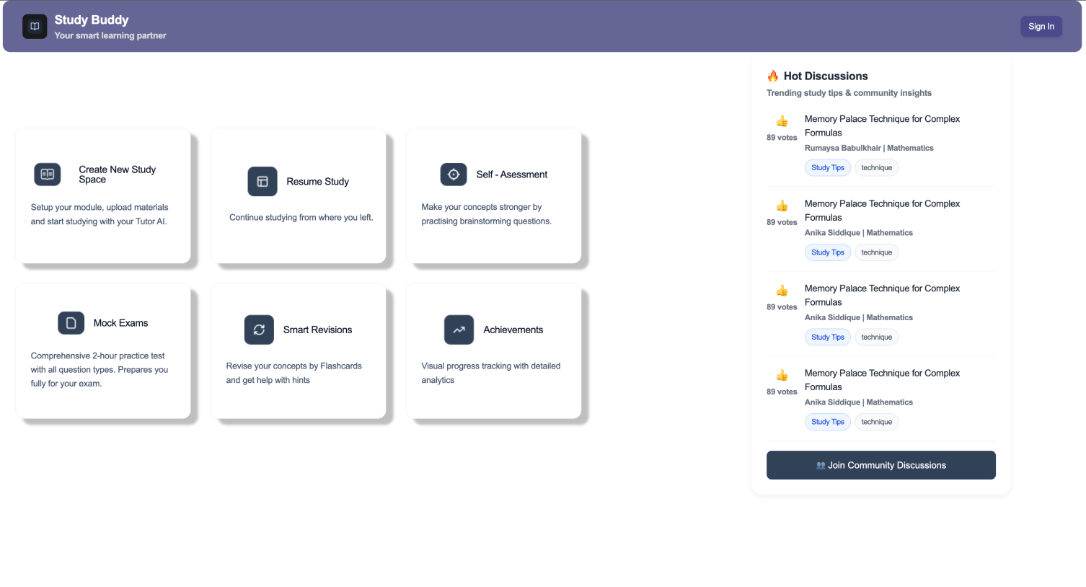
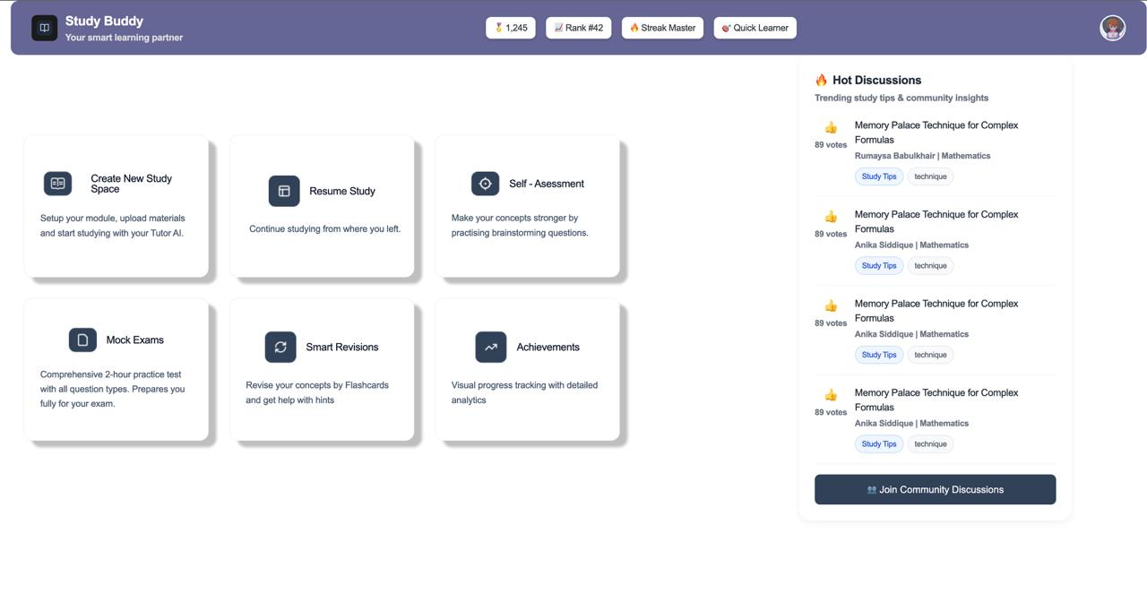
FIGMA TURNED INTO LIVE CODE
Dashboard has been structurally built
Other pages in progress

Slide 22
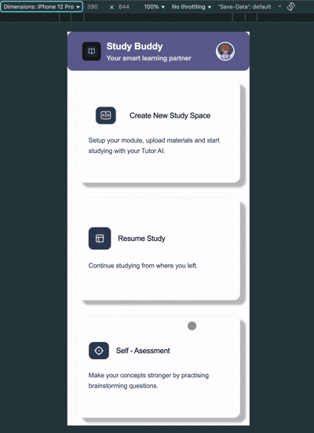
MOBILE PROTOTYPE

Slide 23
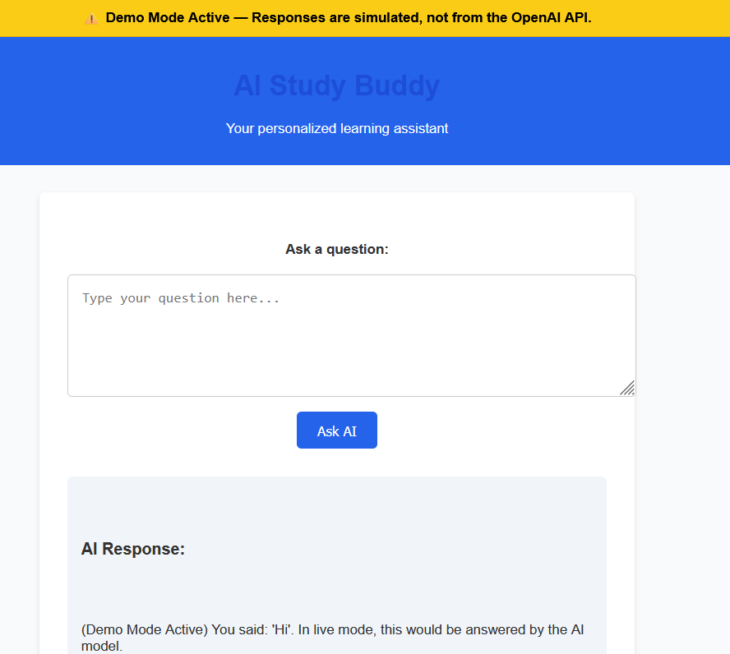
OPENAI API Version

Slide 24



LOGO PROTOTYPE
Feedback received about initial design
Adapted centre to be more fitting for study related service
Bigger companies tend to simplify logos

Slide 25
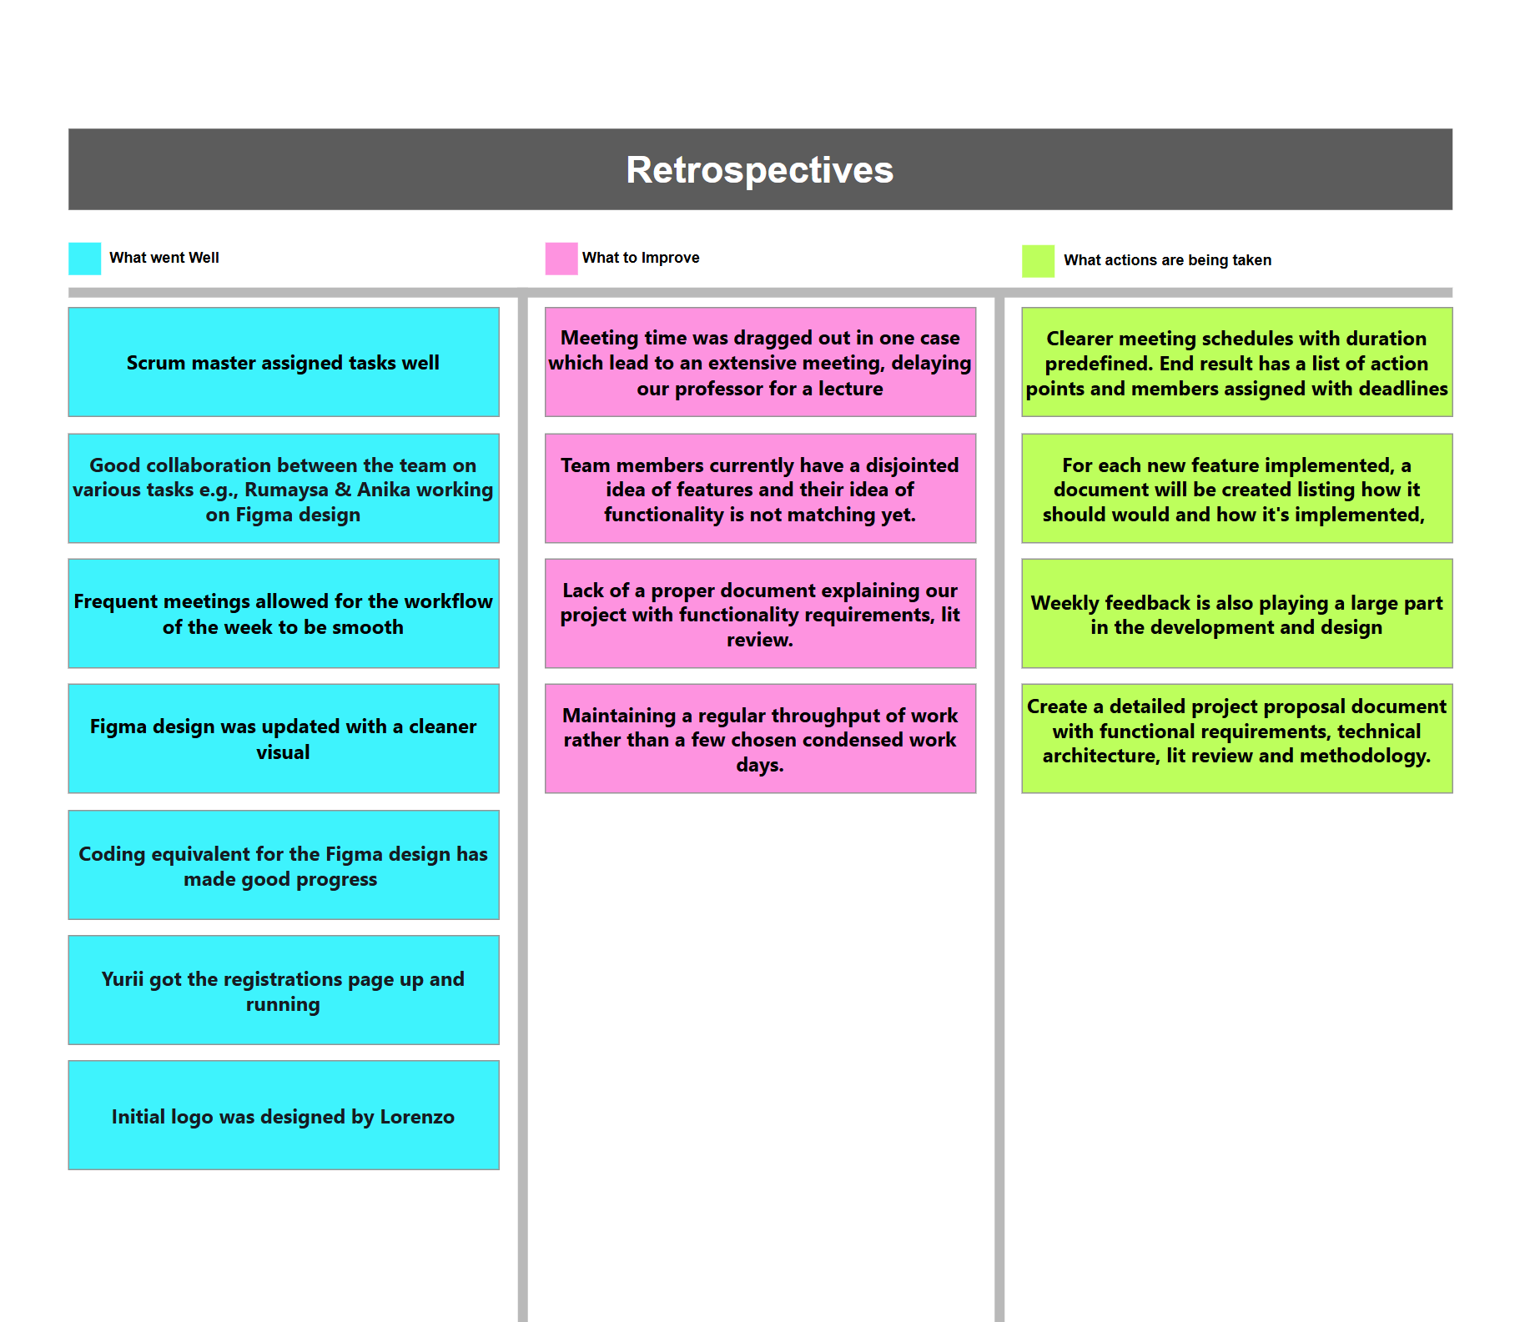

Slide 26
THANK YOU
Any Questions?

